Slide 1
PROJECT
Extending AES from 128-bits to 192 and 256-bits
By,
Zachary Stecher,
Thusharika Nuthalapati,
Bhargavi Madhunula

Slide 2
AES Structure:
It has 10/12/14 rounds in which state undergoes:
Byte substitution(1 S-box used on every byte)
Shift Rows(permutes bytes between groups/columns)
Mix columns(Subs using matrix multiply of groups)
Add round key(XOR state with key material)
It has a simple structure
Only Add Round key uses the key
Decryption uses key in Reverse order
Decryption does recover plaintext
Designed to be resistant to all known attacks

Slide 3
Encryption
Our program encrypts plaintext messages using 128/192/256 bits.
We first initialized variables and matrices.
Initialized S-box , Rcon as matrix
We used Rijndael mix columns
It processes data as block of 4 columns of 4 bytes
Operates on entire block of data in every round

Slide 4
Method
In AesRoundkey we used input for the key size and performed the s-box substitution plus Rcon XOR
Used keyHex as the input
In Aes S-box method, used inHex as the input. This method takes a hex pair string argument and performs the S-box lookup by splitting the pair into 2 separate characters, converting them to their decimal value, and matching the corresponding pair on the table.
In AesRcon method, handles the rcon lookup and XOR for AES round key generation.
The input taken is S and Round
s - The single byte hex value to be XORed with the rcon value
round - the numerical round value to be used in determining which rcon value to use

Slide 5
Contd..
Initial Roundkeys: This method is used for inputting the secret key into matrix K. Pass the key string in as an argument, split the String into pairs and insert each pair into an index of K.
Round XOR method: This method handles the XORing of two single byte values by splitting them in half, converting them to decimal format and then performing the XOR, then converting them back to a String.
Hex2decimal method: This method takes a hexadecimal string value s and transforms it into its corresponding decimal value val. Parameters taken will convert to decimal.

Slide 6
AES encryption method:
This is the algorithm for AES encryption
This method takes a plaintext block of 4x4 and combines it with the 128-bit key to encrypt a message and provide us with a ciphertext.
Input parameters:
pTextHex - The plaintext we want to encrypt (in Hex form)
keyHex - The key we are using to encrypt the plaintext

Slide 7
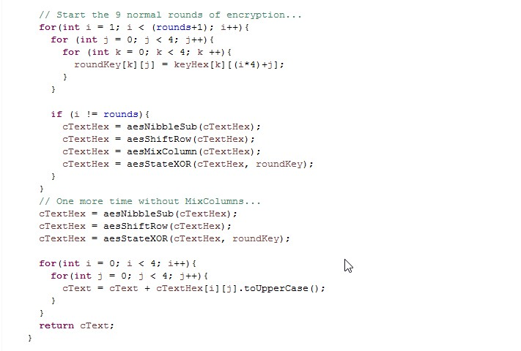
Code for the rounds of encryption

Slide 8
Contd..
State XOR method- this method takes the state input "sHex" and XORs it with the current round's key "keyHex", and returns the result outStateHex".
AesNibbleSub method: This method takes a 4x4 matrix input(the "state") and performs the Sbox substitution, outputting the result.
The input is instateHex , the state matrix in which we performed the substitutions.
ShiftRows method: This method takes a 4x4 matrix input(the "state") and shifts each row to the left in increasing increment (0, 1, 2, 3).

Slide 9
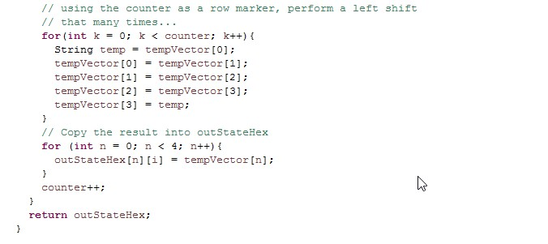
Contd..
A circular byte in each shift
1st row is unchanged
2nd row does 1 byte circular shift to left
3rd row does 2 byte circular shift to left
4th row does 3 byte circular shift to left

Slide 10

Mix Columns method:
This method performs the MixColumn step of AES utilizing multiplication lookup tables rather than Galois matrix multiplication.
We have used Rijndael mix columns,
Each column is processed separately
Each byte is replaced by a value dependent on all 4 bytes in the column
Code-(table for performing lookups and XORs)

Slide 11
Decryption:
AES decryption is not identical to encryption since steps done in reverse
but can define an equivalent inverse cipher with steps as for encryption
Uses inverses of each step
With a different key schedule
Works since result is unchanged when
Swap bytes substitution and shifting rows
Swap mix columns and AddRoundkey
Shift rows is simple byte shift
AddRoundkey works on byte XOR’s
Mix columns requires matrix multiply which works on byte values, can be simplified to use table lookups & byte XOR’s

Slide 12
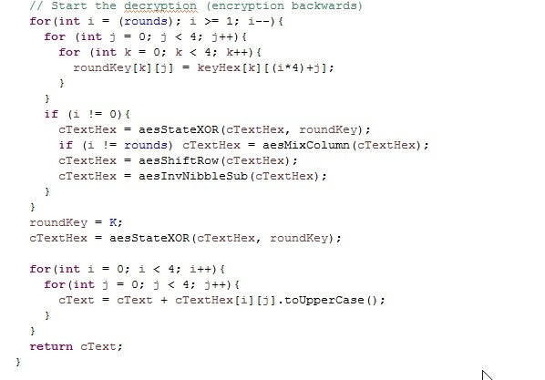
We have used s-box and the inverse s-box for the decryption process.(from the Rijndael s-box)
And also the mix-columns were taken from the Rijndael mix-columns for the decryption
Decryption method: This is the encryption backwards.

Slide 13
Driver file- The driver file contains the main method for encryption and decryption process and returns the output.
Padding: We have used ECB mode for our project, padding with the number of padded bytes appended
Advantages of ECB:
Easy to Implement
Disadvantages of ECB:
Message repetitions may show in cipher text
Not really secure

Slide 14
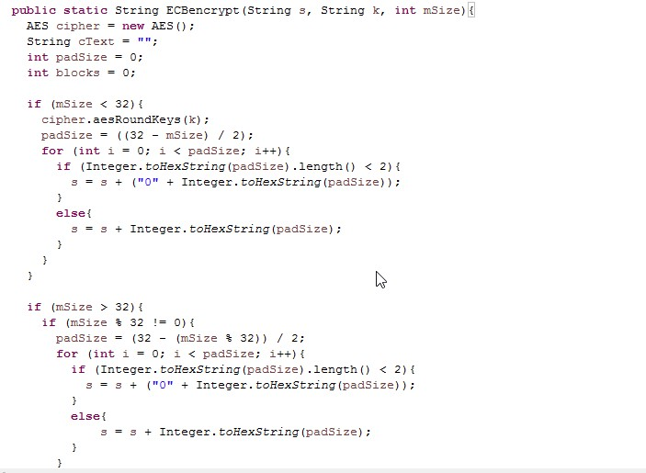
Code for ECBEncrypt:

Slide 15
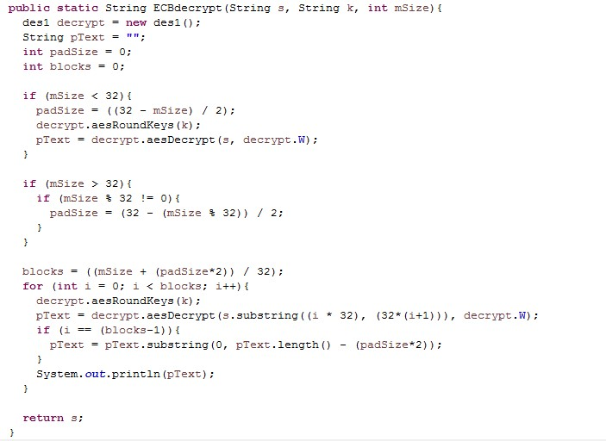
Code for ECBDecrypt:

Slide 16
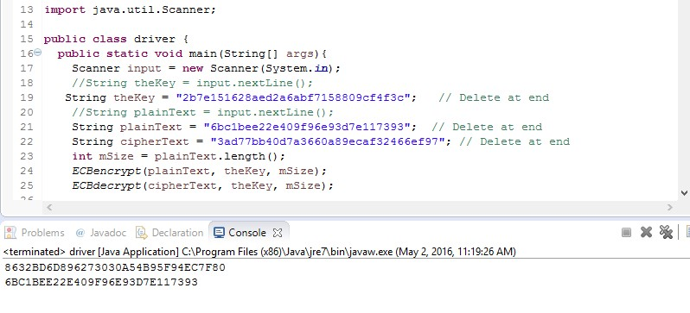
Output:
We tested our program by using Test vectors from
http://www.inconteam.com/software-development/41-encryption/55-aes-test-vectors
It works for 128,192 and 256 bit keys.
Output for AES ECB 128 bit encryption

Slide 17
Authentication Strategy
SHA3 authentication strategy is used to determine that the message is from a valid source.
The capacity of SHA3 is twice the output length.
In SHA3 the security increases with higher capacities.

Slide 18


